Slide 1
Gathered Around the Table
The Marist Way

Slide 2
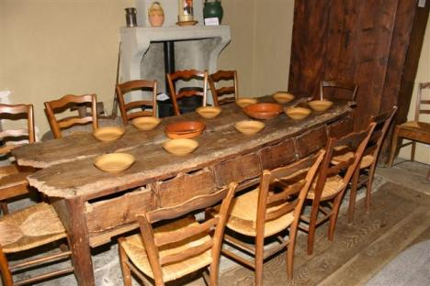

Slide 3
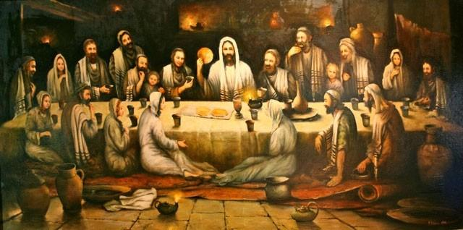

Slide 4
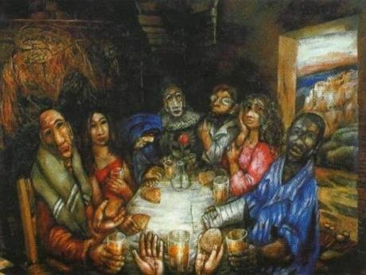

Slide 5
